Slide 1



Smart Traffic Management
System
Leveraging IoT and AI for Optimized Traffic Flow
next slide

Slide 2

OUR TEAM
SEIF ELDIN
AHMED
SABRY
MOHAMED OSAMA
BAKR
KARIM ALAA
AHMED HANY
AHMED AMIN

Slide 3

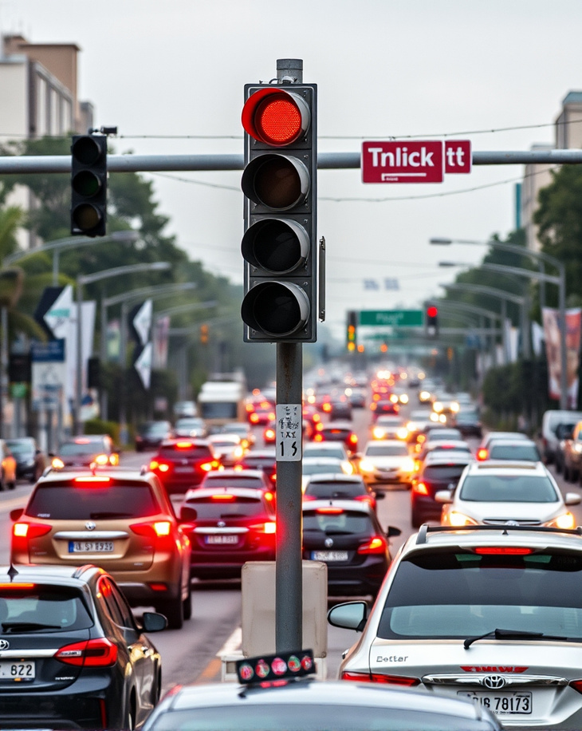
03
Problem
Congestion: Urban areas suffer from high traffic congestion, leading to delays and increased pollution.
Inefficient Traffic Lights: Traditional traffic lights operate on fixed timers, not adapting to real-time conditions.
Emergency Vehicle Delays: Emergency vehicles are significantly delayed in heavy traffic, posing safety risks.
Accident-Prone Areas: Identifying and managing accident-prone zones is crucial for safety.
3
next slide

Slide 4
03
Problem
Accidents: 3% of the population experiences traffic accidents.
Traffic Problems: 30% of the population encounters issues and loses time due to traffic congestion.
Ambulance Delays: A significant percentage of patients (exact number unspecified) have died due to delays in ambulance response.
next slide

Slide 5

02
Objective
Introduce the system aimed at optimizing traffic flow and reducing congestion using IoT technologies.
next slide

Slide 6
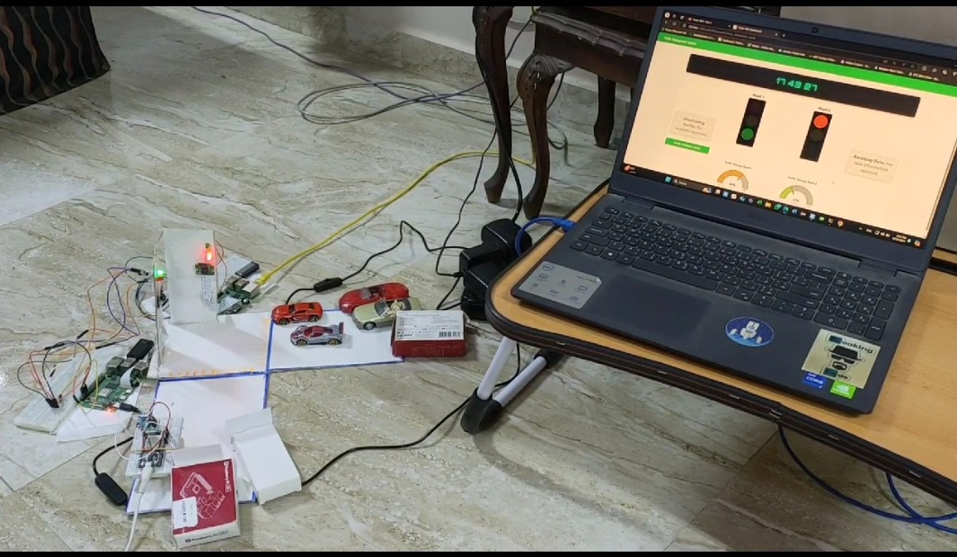
Solution
04
Implement Raspberry Pi equipped with cameras and YOLO technology to assess and analyze vehicle density on the road.
Adjust traffic signals in real-time based on current traffic conditions through MQTT communication.
Enable immediate override of standard traffic signals to facilitate the swift passage of emergency vehicles.
Utilize BLE technology to detect vehicle proximity in high-risk areas, allowing for timely adjustments of traffic signals.
next slide

Slide 7
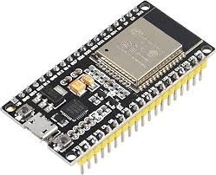
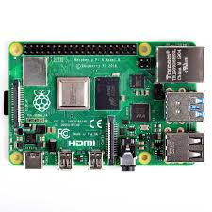
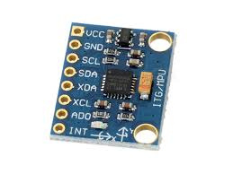

Materials
17
ESP32
RASBBERY PI 4&3
MPU 6050 SENSOR
next slide

Slide 8
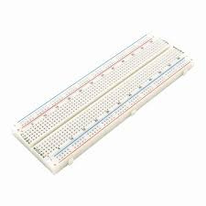
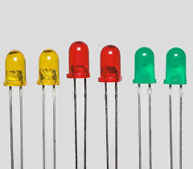
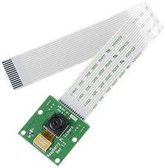
Materials
18
BREADBOARD
6 LEDS
2 RSPBERRY CAMERAS
next slide

Slide 9
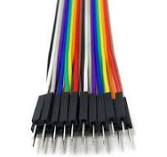

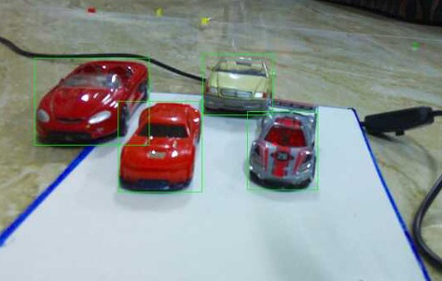
Materials
19
JUPMBERS
THICK PAPER
MACET CARS
next slide

Slide 10



Tools
20
HIVEHQ
NODE RED
YOLO MODEL
next slide

Slide 11

YOlO Model
21
Real-Time Detection: It analyzes video feeds from cameras installed at intersections to detect vehicles instantly.
Accuracy: YOLO is trained on traffic-specific datasets, allowing it to accurately identify and classify vehicles, which is vital for making informed traffic management decisions.
Bounding Boxes: The model outputs bounding boxes around detected vehicles, enabling your system to count the number of vehicles on each road.
YOLO MODEL
next slide

Slide 12
Node-RED
22
Data Integration: Node-RED collects vehicle count data sent from the Raspberry Pi using MQTT.
Traffic Management: It processes this data to assess vehicle density at intersections, enabling it to trigger actions such as adjusting traffic light statuses.
User Interface: Node-RED provides a dashboard that visualizes traffic light states and road density, allowing real-time monitoring of traffic conditions.
NODE-RED
next slide

Slide 13
HIVEMQ
23
Message Routing: HiveMQ efficiently routes messages between the cameras and Node-RED, ensuring reliable data transmission
Scalability: It supports the addition of multiple devices, allowing your system to grow without performance issues as more cameras or sensors are integrated.
Data Management: HiveMQ handles incoming data streams, ensuring that vehicle counts and emergency signals are processed smoothly and promptly.
HIVEMQ
next slide

Slide 14


05
System Consists of
ADAPTIVE TRAFFIC LIGHT SYSTEM
EMERGENCY VEHICLE RESPONDING SYSTEM AI
ACCIDENT DETECTION SYSTEM
next slide

Slide 15
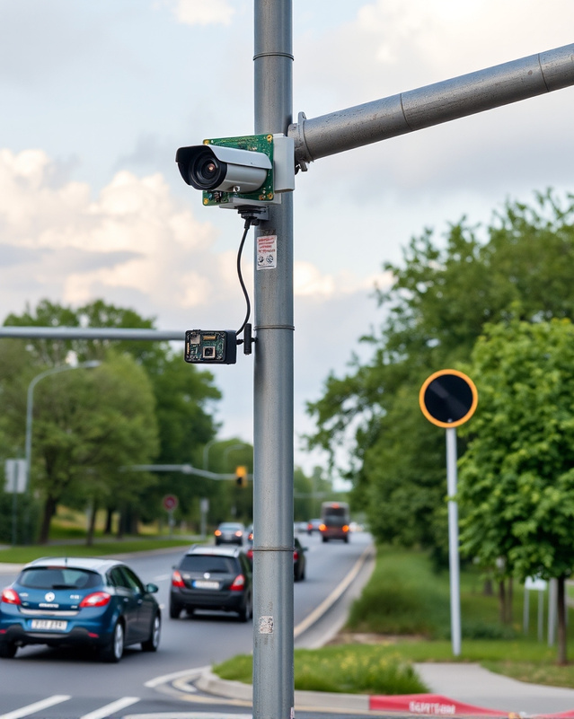
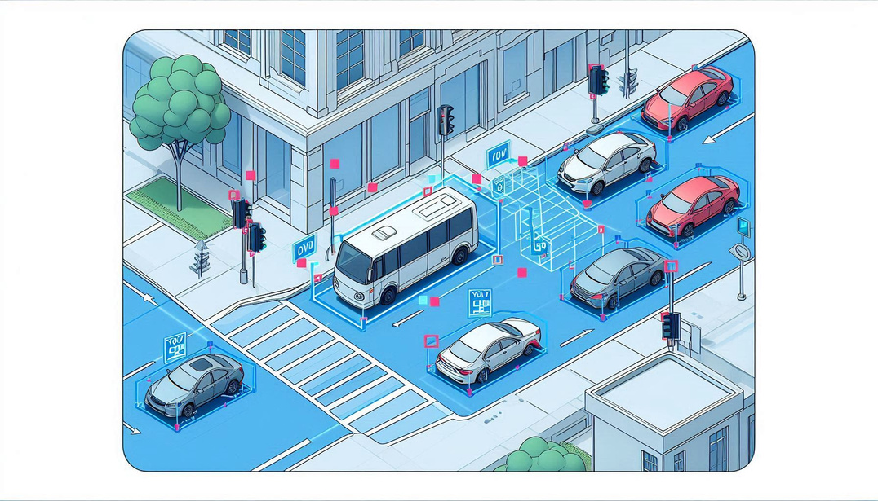
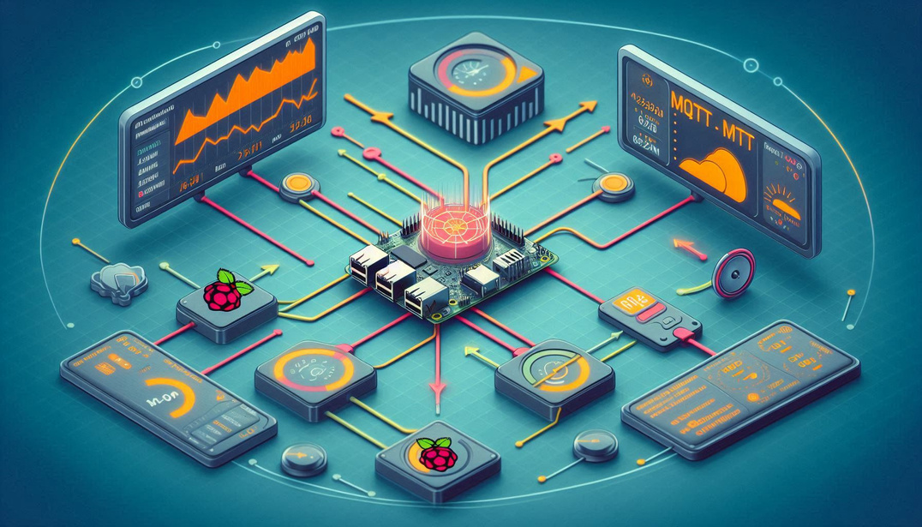

06
Adaptive Traffic light
system
Monitoring Begins: Raspberry Pi Cameras Installed on Two Roads
YOLO Model in Action: Determining Vehicle Counts in Real Time
Data Transmission: Vehicle Counts Sent via MQTT to Node-RED for Traffic Control

Slide 16
Image processing
24
Camera Setup: High-resolution cameras are installed at intersections to capture real-time video feeds.
YOLO Model: The YOLO (You Only Look Once) model is utilized for real-time object detection, trained on traffic-specific datasets to accurately identify and classify vehicles.
Frame Analysis: As frames are captured, the YOLO model processes each one, generating bounding boxes around detected vehicles and providing class labels.
Vehicle Counting: The system counts the number of vehicles detected in each frame and relays this data to Node-RED.
Data Transmission: Detected vehicle counts are sent via MQTT to ensure real-time updates for traffic management decisions.
next slide

Slide 17
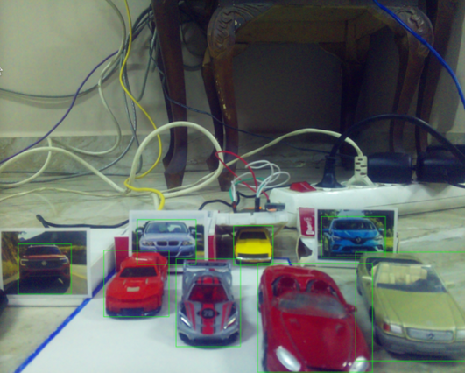

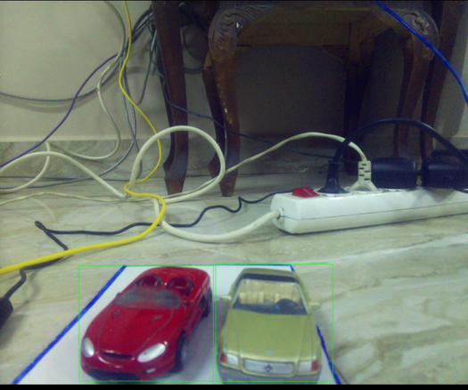
Image processing
18
7 CARS DETECTION
4 CARS DETECTION
2 CARS DETECTION
next slide

Slide 18

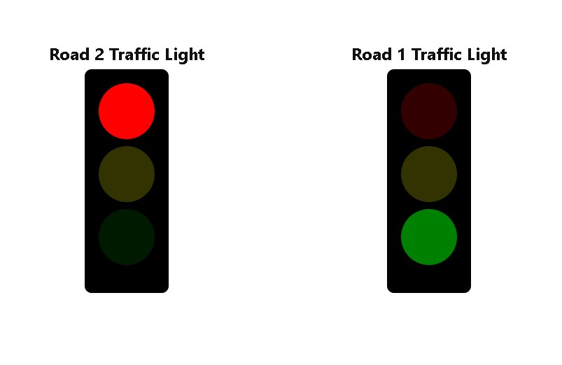
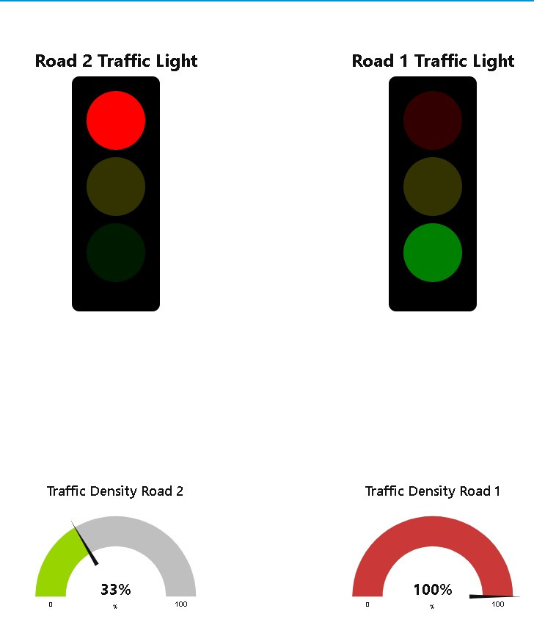
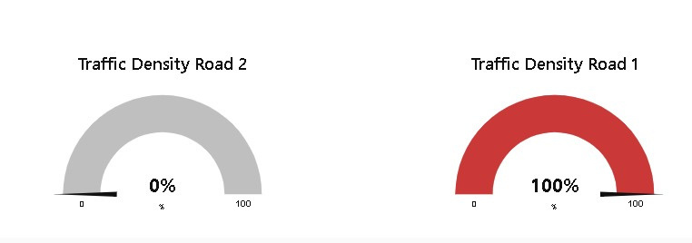
07
Adaptive Traffic light
system
State 1

Slide 19
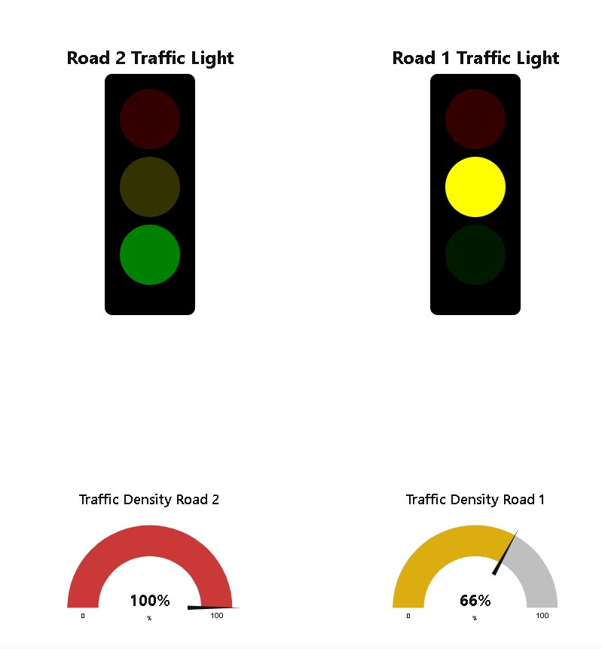
08
Adaptive Traffic light
system
State 2

Slide 20
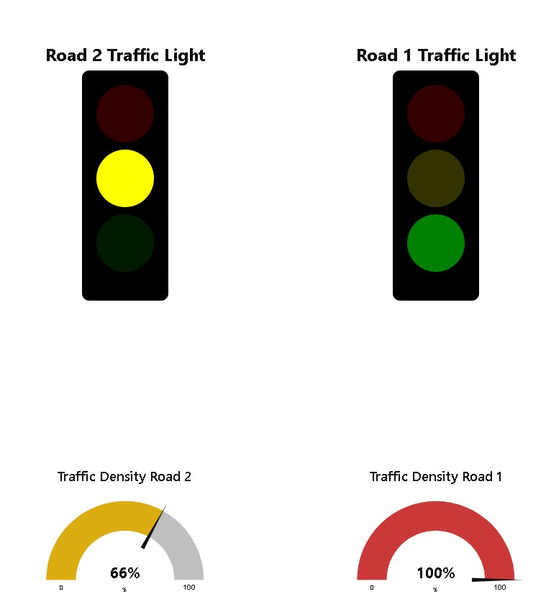
09
Adaptive Traffic light
system
State 3

Slide 21



10
Emergency Vehicle Responding System
Emergency Vehicle send message
Signal Sent
Normal Traffic Resumes: Road Lights Return to Adaptive State After Ambulance Passage

Slide 22
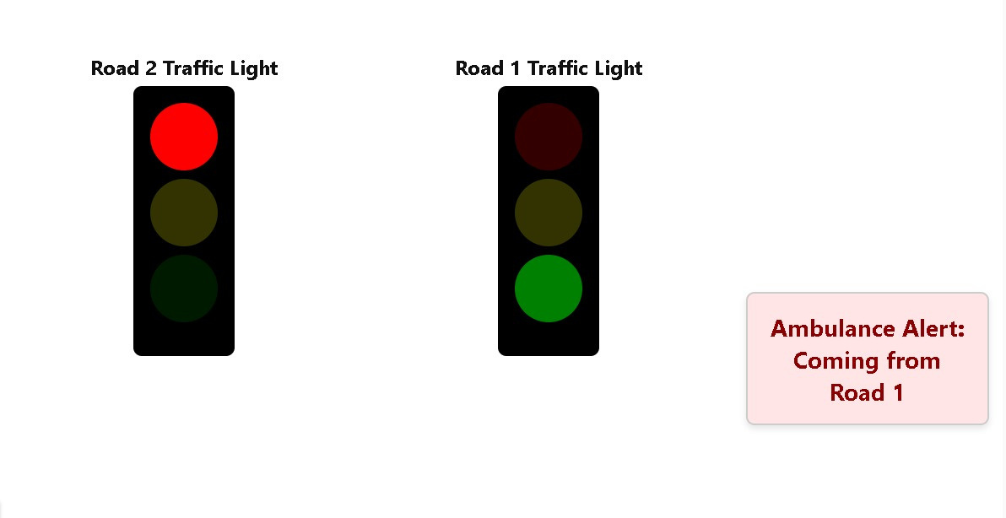
11
Emergency Vehicle Responding System
State 1

Slide 23
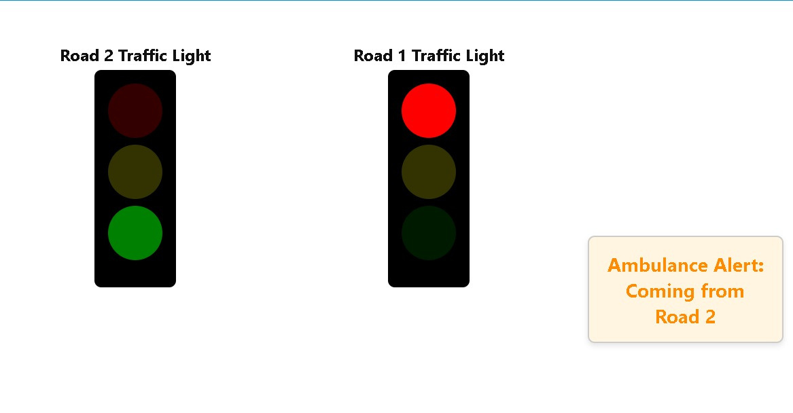
12
Emergency Vehicle Responding System
State 2

Slide 24
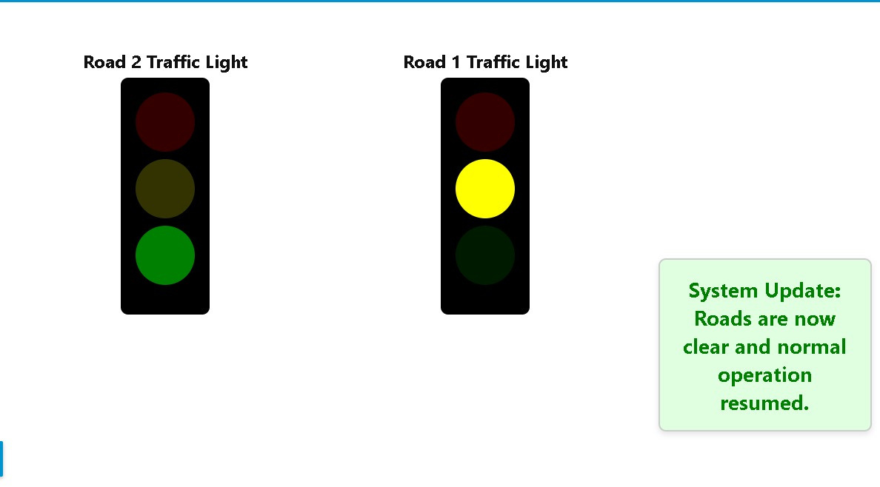
13
Emergency Vehicle Responding System
State 3

Slide 25
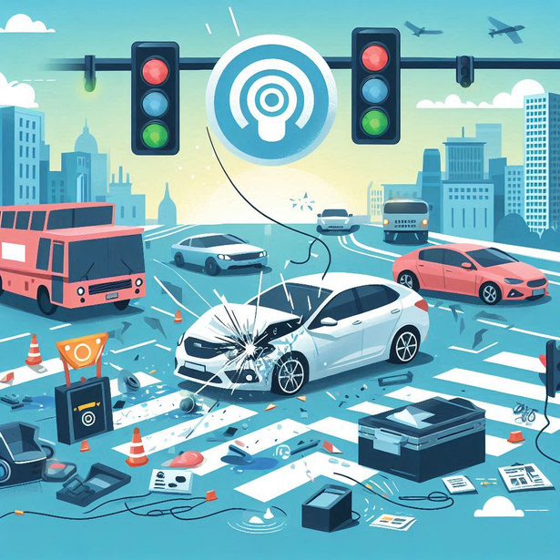

14
Accident Detection System
Accident Detected by IMU sensor signal
Location Determined: Bluetooth Signals Guide Raspberry Pi in Identifying Accident Road

Slide 26
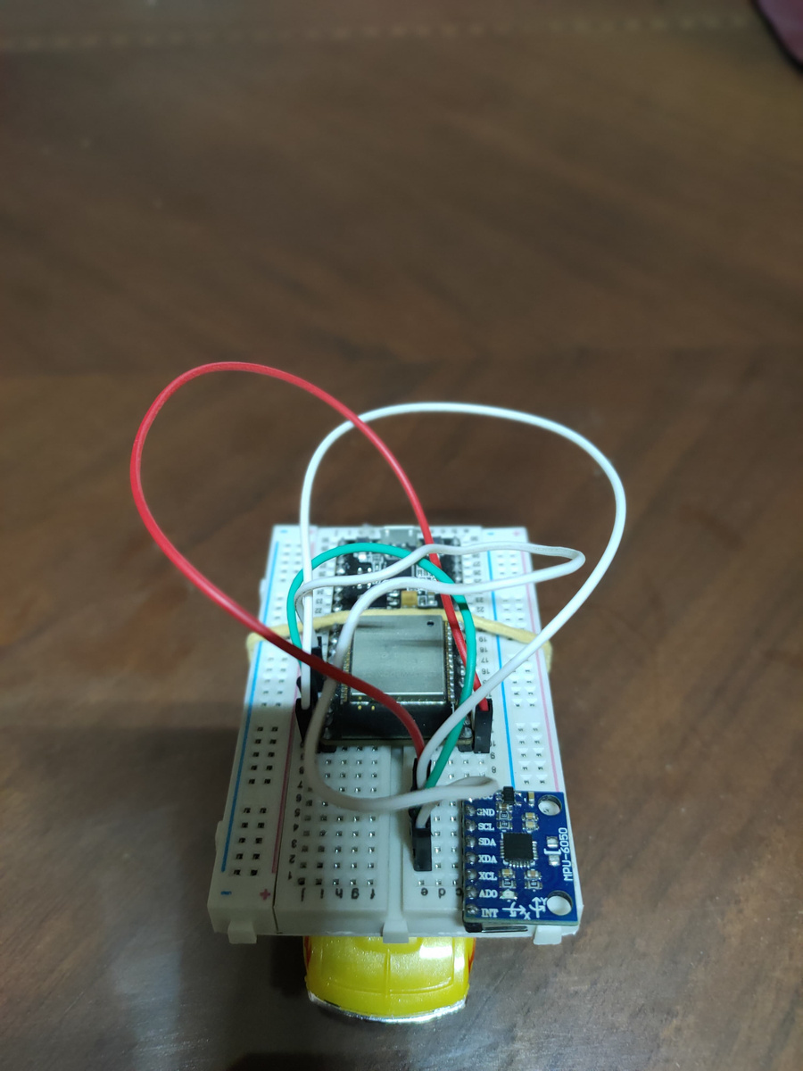
Car circuit
23
The car is designed for accident detection using an ESP32 microcontroller, which features a Bluetooth module for connectivity.
The components, including the MPU6050 sensor, are connected with jumpers on a breadboard to facilitate communication and data processing
next slide

Slide 27
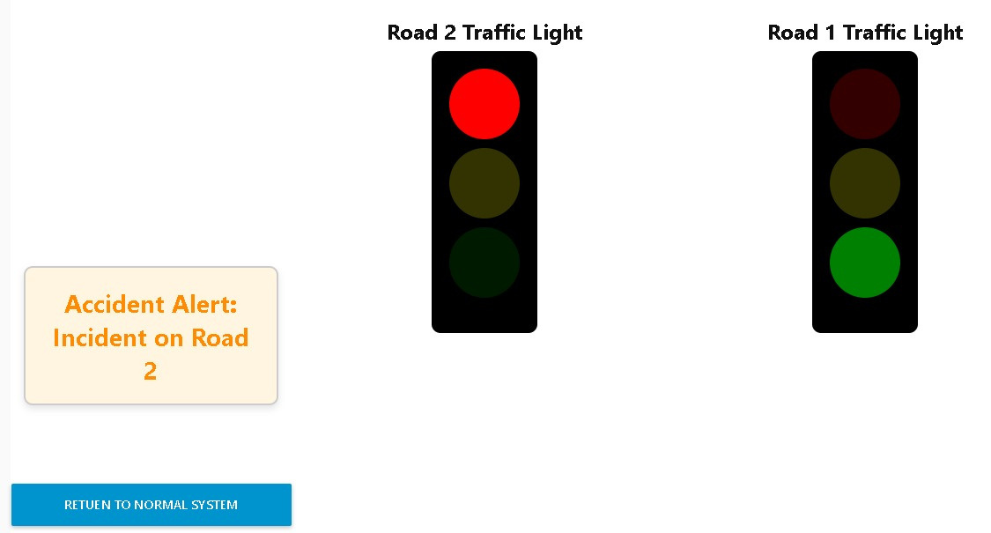
15
Accident Detection System
State 1

Slide 28
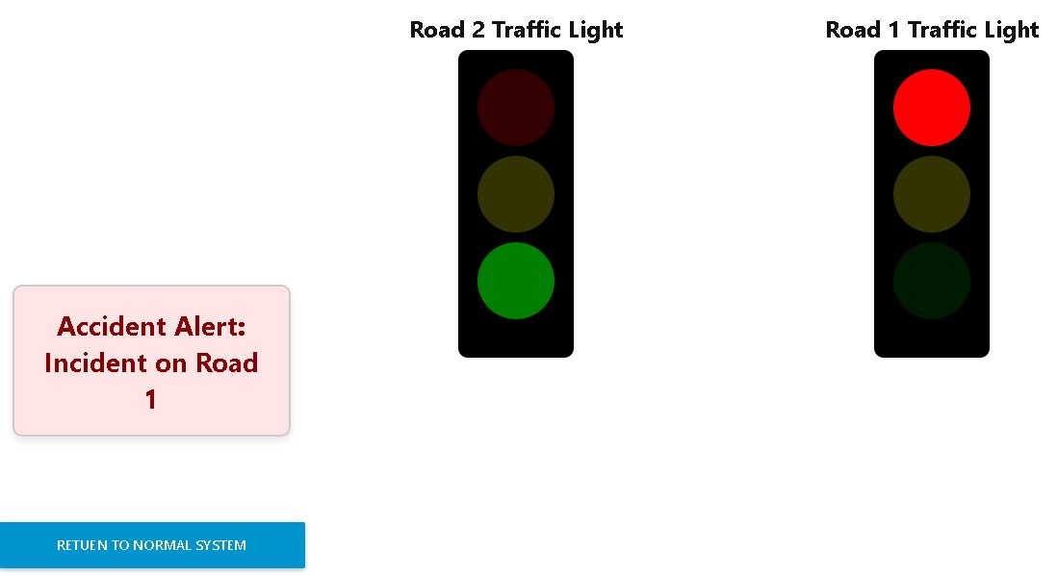
16
Accident Detection System
State 2

Slide 29


27
System Architecture
NodeRed

Slide 30
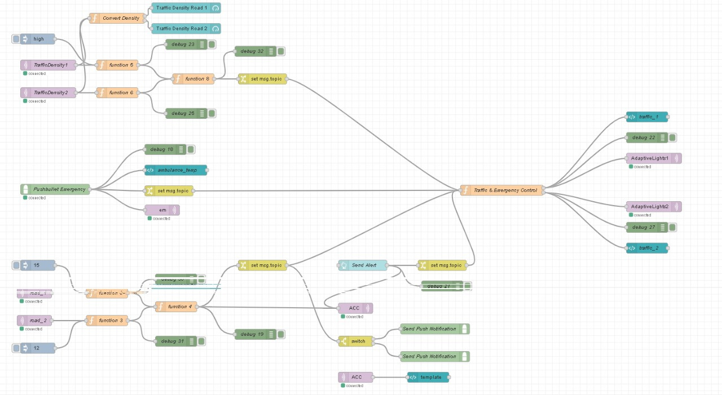
28
System Architecture

Slide 31
Recommendations
25
Use GPS for Location Tracking: Implement GPS technology in vehicles to determine precise locations instead of relying on Bluetooth signal strength. This will improve accuracy in detecting accidents and monitoring traffic flow.
Integrate Machine Learning: Enhance the YOLO model with machine learning algorithms that adapt over time, improving vehicle detection accuracy under various conditions (e.g., weather changes, different times of day).
Develop a Mobile App for Users: Create an app for drivers that provides real-time traffic updates, alerts for accidents, and navigation suggestions based on current traffic conditions.
next slide

Slide 32
Recommendations
26
Enhance Security Measures: Ensure robust data encryption for all communications between devices to protect against unauthorized access and ensure user privacy.
User Feedback Mechanism: Include a feedback mechanism in the mobile app or web interface to gather user input on traffic conditions, which can help improve the system's responsiveness and functionality.
Consider Environmental Factors: Explore the integration of weather data to adjust traffic light timings and alerts based on real-time environmental conditions.
next slide

Slide 33
29
Thank You!

